Slide 1

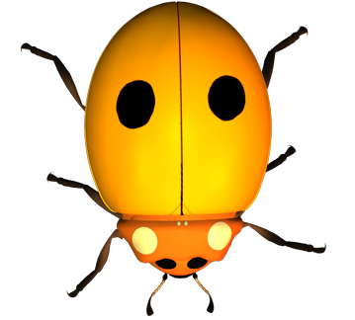
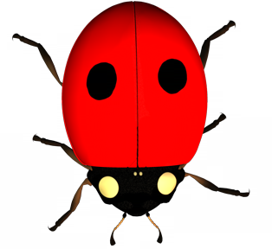
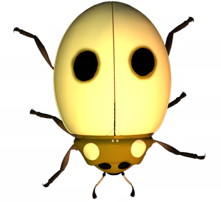

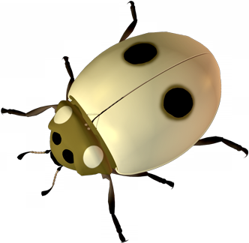
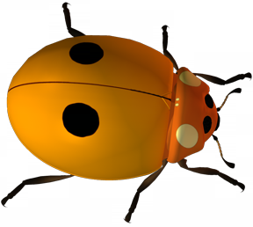

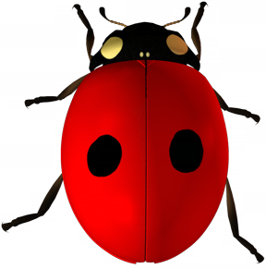
Evolution Series: Set 1
Copyright © 2005
Version: 2.0

Slide 2
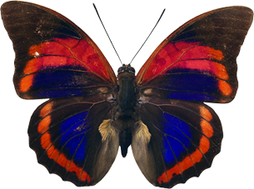
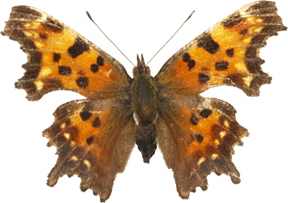
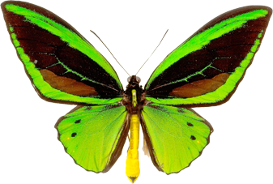
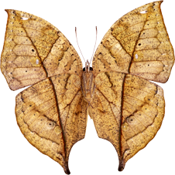
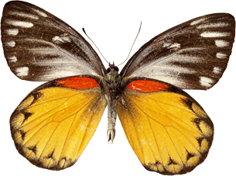
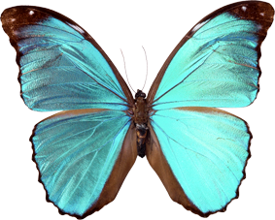
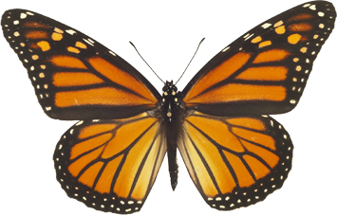
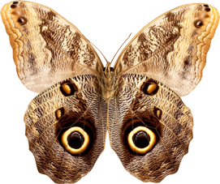
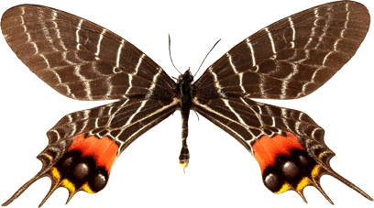
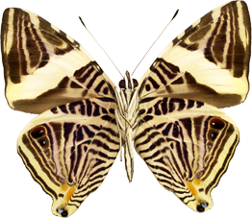
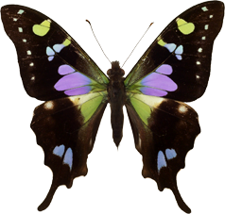
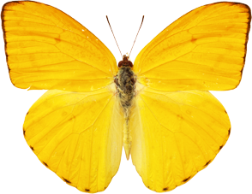
Species
A biological species is:
a grouping of organisms that can interbreed and are reproductively isolated from other such groups.
Species are recognized on the basis of their morphology (size, shape, and appearance) and, more recently, by genetic analysis.
For example, there are up to 20 000 species of butterfly; they are often very different in appearance and do not interbreed.

Slide 3
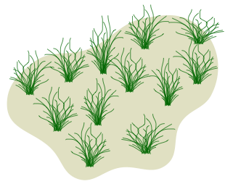
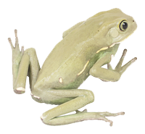
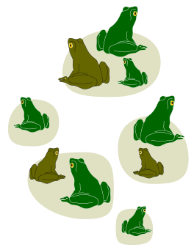

Populations
From a population genetics viewpoint:
  A population comprises the total number of one species in a particular area.
  All members of a population have the potential to interact with each other. This includes breeding.
Populations can be very large and occupy a large area, with fairly continuous distribution.
Populations may also be limited in their distribution and exist in isolated pockets or “islands”, cut off from other populations of the same species.
Continuous distribution
Example: human population, Arctic tundra plant species
Fragmented distribution
Example: Some frog species

Slide 4
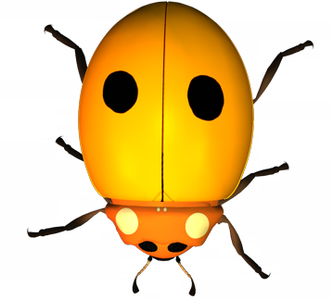
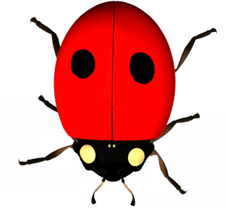
Gene Pool
AA
Aa
AA
A gene pool is defined as the sum total of all the genes present in a population at any one time.
  Not all the individuals will be breeding at a given time.
  The population may have a distinct geographical boundary.
  Each individual is a carrier of part of the total genetic complement of the population.
AA
aa
Aa
aa
Aa
aa
Aa
AA
AA
aa
Aa
AA
A gene pool made up of 16 individuals
Aa

Slide 5
Gene Pool
Geographic boundary of the gene pool
Individual is homozygous recessive (aa)
AA
Aa
aa
AA
AA
Aa
Aa
Individual is homozygous dominant (AA)
aa
aa
AA
Aa
aa
Aa
Aa
AA
AA
aa
Individual is heterozygous (Aa)
A gene pool made up of 16 individual organisms with gene A, and where gene A has two alleles

Slide 6
Analyzing a Gene Pool
By determining the frequency of allele types (e.g. A and a) and genotypes (e.g. AA, Aa, and aa) it is possible to determine the state of the gene pool.
The state of the gene pool will indicate if it is stable or undergoing change. Genetic change is an important indicator of evolutionary events.
There are twice the number of alleles for each gene as there are individuals, since each individual has two alleles.
Aa
Aa
AA
aa
Aa
AA
Aa
Aa
aa

Slide 7

Analyzing a Gene Pool
EXAMPLE
  The small gene pool above comprises 8 individuals.
  Each individual has 2 alleles for a single gene A, so there are a total of 16 alleles in the population.
  There are individuals with the following genotypes:
    homozygous dominant (AA)
    heterozygous (Aa)
    homozygous recessive (aa)
Aa
AA
aa
Aa
Aa
AA
Aa
Aa
Aa

Slide 8
Determining
Allele Frequencies
To determine the frequencies of alleles in the population, count up the numbers of dominant and recessive alleles, regardless of the combinations in which they occur.
Convert these to percentages by a simple equation:
Aa
AA
aa
Aa
Aa
AA
Aa
No. of dominant alleles
Aa
X 100
Total no. of alleles
Aa

Slide 9
Determining
Genotype Frequencies
To determine the frequencies of different genotypes in the population, count up the actual number of each genotype in the population:
  homozygous dominant (AA)
  heterozygous (Aa)
  homozygous recessive (aa).
Aa
AA
aa
Aa
Aa
AA
Aa
Aa
Aa

Slide 10
Changes in a Gene Pool 1
Phase 1: Initial gene pool
  In the gene pool below there are 25 individuals, each possessing two copies of a gene for a trait called A.
  This is the gene pool before changes occur:
A | a | AA | Aa | aa
27 | 23 | 7 | 13 | 5
54 | 46 | 28 | 52 | 20
Allele types
Allele combinations
aa
AA
Aa
Aa
Aa
AA
aa
Aa
Aa
AA
AA
Aa
Aa
Aa
Aa
Aa
aa
AA
Aa
aa
Aa
aa
AA
AA
Aa

Slide 11
Changes in a Gene Pool 2
Phase 2: Natural selection
  In the same gene pool, at a later time, two pale individuals die due to the poor fitness of their phenotype.
A | a | AA | Aa | aa
27 | 19 | 7 | 13 | 3
58.7 | 41.3 | 30.4 | 56.5 | 13.0
No.
%
Two pale individuals died and therefore their alleles are removed from the gene pool
Allele types
Allele combinations
aa
AA
Aa
Aa
Aa
AA
aa
Aa
Aa
AA
AA
Aa
Aa
Aa
Aa
Aa
aa
AA
Aa
aa
Aa
aa
AA
AA
Aa

Slide 12
Changes in a Gene Pool 3
Phase 3: Immigration/Emigration
  Later still, one beetle (AA) joins the gene pool, while another (aa) leaves.
A | a | AA | Aa | aa
29 | 17 | 8 | 13 | 2
63 | 37 | 34.8 | 56.5 | 8.7
This individual is entering the population and will add its alleles to the gene pool
This individual is leaving the population, removing its alleles from the gene pool
Allele types
Allele combinations
AA
AA
Aa
Aa
Aa
AA
aa
Aa
Aa
AA
AA
Aa
Aa
Aa
Aa
Aa
aa
AA
Aa
Aa
aa
AA
AA
Aa

Slide 13
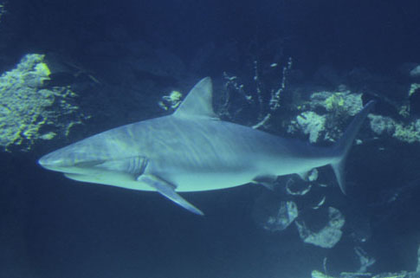
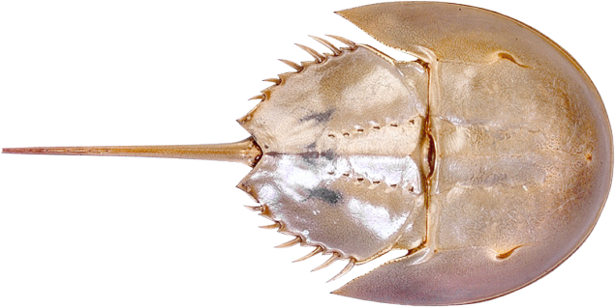
Hardy-Weinberg Equilibrium
Populations that show no phenotypic change over many generations are said to be stable. This stability over time was described mathematically
by two scientists:
  G. Hardy: an English mathematician
  W. Weinberg: a German physician
The Hardy-Weinberg law describes the genetic equilibrium of large sexually reproducing populations.
  The frequencies of alleles in a population will remain constant from one generation to the next unless acted on by outside forces.
Sharks and horseshoe crabs (Limulus) have remained phenotypically stable over many millions of years.

Slide 14
Conditions Required for
Hardy-Weinberg Equilibrium
The genetic equilibrium described by the Hardy-Weinberg law is only maintained in the absence of destabilizing events; all the stabilizing conditions described below must be met:
1 | Large population: The population size is large.
2 | Random mating: Every individual of reproductive age has an equal chance of finding a mate.
3 | No migration: There is no movement of individuals into or out of the population (no gene flow).
4 | No selection pressure: All genotypes have an equal chance of reproductive success.
5 | No mutation: There are no mutations, which might create new alleles in the population.
  Natural populations seldom
  meet all these requirements....
  .....therefore allele frequencies
  will change
  A change in the allele
  frequencies in a population
  is termed microevolution.

Slide 15
The Hardy-Weinberg Equation
The Hardy-Weinberg equation provides a simple mathematical model of genetic equilibrium.
It is applied to populations with a simple genetic situation: recessive and dominant alleles controlling a single trait.
The frequency of all of the dominant alleles (A) and recessive alleles (a) equals the total genetic complement, and adds up to 1 (or 100%) of the alleles present.
p represents the frequency of allele A while q represents the frequency of allele a in the population.
Frequency of allele combination AA in the population
Punnett square
p
q
pp | pq
qp | qq
p
q
Frequency of allele combination Aa in the population (add these together to get 2pq)
Frequency of allele combination aa in the population

Slide 16
The Hardy-Weinberg Equation
The Hardy-Weinberg equilibrium can be expressed mathematically by giving the frequency of all the allele types in the population:
  The sum of all the allele types: A and a = 1 (or 100%)
  The sum of all the allele combinations: AA, Aa, and aa = 1 (or 100%)
Frequency of allele combination: AA (homozygous dominant)
Frequency of allele combination: Aa (heterozygous)
Frequency of allele: a
Frequency of allele: A
Frequency of allele combination: aa (homozygous recessive)
(p + q)² = p² + 2pq + q² = 1
Frequency of
allele types
Frequency of
allele combinations

Slide 17
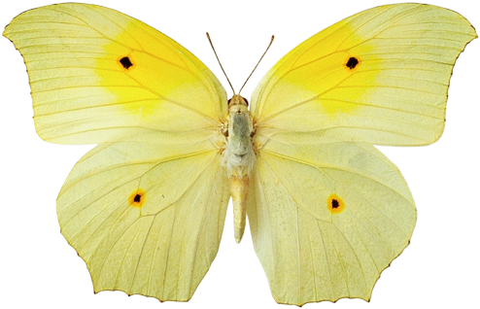
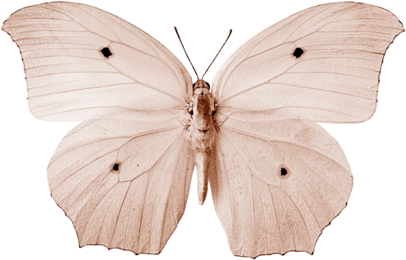
How to Solve H-W Problems
The procedure for solving a Hardy-Weinberg problem is straightforward.
Use decimal fractions (NOT PERCENTAGES) for all calculations!
    Determine what information you have about the population. In most cases, it is the percentage or frequency of the recessive phenotype (q²) or the dominant phenotype (p² + 2pq). These provide the only visible means of gathering data about the gene pool.
    The first objective is to find out the value of p or q. If this is achieved, then every other value in the equation can be determined by simple calculation. If necessary q² can be obtained by:
    Take the square root of q² to find q
    Determine p by subtracting q from 1 (i.e. p = 1 – q)
    Determine p² by multiplying p by itself (i.e. p² = p x p)
    Determine 2pq by multiplying p X q X 2
    Check the calculations by adding p² + 2pq + q²: these
    should always equal 1.
1 – frequency of the dominant phenotype
Dominant phenotype = p² + 2pq
Recessive phenotype
= q²

Slide 18
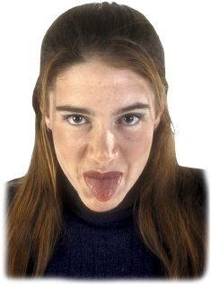

A Worked Example
Around 70% of caucasian Americans can taste the chemical P.T.C. (the dominant phenotype). 30% are non-tasters (the recessive phenotype).
  Frequency of the dominant phenotype = 70% or 0.7
  Frequency of the recessive phenotype = 30% or 0.3
Recessive phenotype: q² = 0.30
  therefore: q = 0.5477 (square root of 0.30)
  therefore: p = 0.4523 (1 – 0.5477 = 0.4523)
Use p and q in the equation to solve any unknown:
  Homozygous dominant: p² = 0.2046 (0.4523 x 0.4523)
  Heterozygous: 2pq = 0.4953 (2 x 0.4522 x 0.5477)
    Frequency of homozygous recessive phenotype = q² = 30%
    Frequency of dominant allele (p) = 45.2%
    Frequency of homozygous tasters (p²) = 20.5% and heterozygous tasters (2pq) = 49.5%

Slide 19
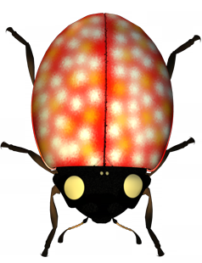
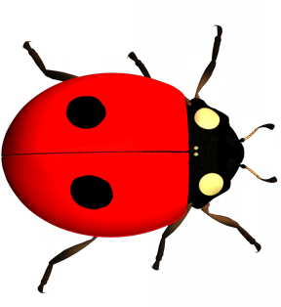
Changing Allele Frequencies
Gene pools are subjected to processes that can alter allele frequencies:
  Mutation: Spontaneous mutations can alter alleles
  frequencies and create new alleles.
  Gene flow: Genes can be exchanged with other
  gene pools as individuals move between them.
  Small population size and genetic drift:
  In small populations, allele frequencies
  can change randomly from generation
  to generation; alleles may be lost or fixed.
  Natural selection: Selection pressure against
  certain alleles combinations may reduce reproductive success.
  Non-random mating: Individuals seek out
  particular phenotypes with which to mate.
Some of these processes cause random changes, others may be directional (i.e. they favor some alleles at the expense of others).
AA
A’A

Slide 20
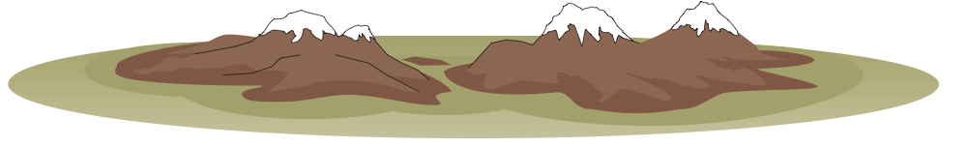
Changing Allele Frequencies
Emigration
AA
aa
Aa
aa
AA
Aa
AA
Aa
Aa
Aa
Immigration
Aa
AA
Aa
Aa
aa
Aa
Aa
AA
AA
AA
aa
AA
A’A
Aa
Boundary of gene pool
Natural selection
Mutation
Mate selection (non-random mating)
Gene flow
Geographical barrier
Aa
Aa
Aa
Aa
aa
Aa
AA
Aa
aa
aa
Aa
Aa
aa
aa
Aa
aa
Genetic drift

Slide 21
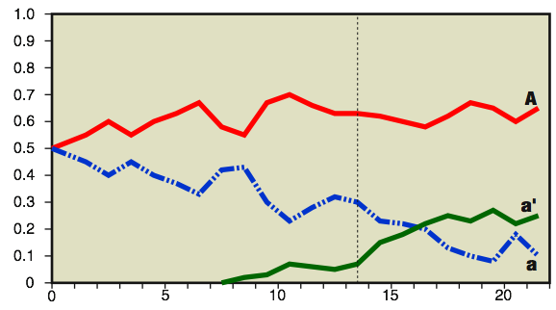
Mutations
New recessive
allele
AA
Aa
Mutations are the source of all new alleles.
Mutations can therefore change the frequency of existing alleles by competing with them.
Recurrent spontaneous mutations may become common in a population if they are not harmful and are not eliminated.
AA
AA
a’a
In the graph below, a mutation creates a new recessive allele: a'
The frequency of this new allele increases when environmental conditions change, giving it a competitive advantage over the other recessive allele: a
Aa
aa
Aa
Aa
Aa
aa
Aa
Aa
Aa
AA
AA
aa
AA
Aa
aa
Environmental conditions change
Allele frequency
Mutation causes the formation of a new recessive allele
Generations

Slide 22


Gene Flow
AA
Barriers to gene flow
Gene flow is the movement of genes into or out of a population (immigration and emigration).
A population may gain or lose alleles through gene flow.
Gene flow tends to reduce the differences between populations because the gene pools become more similar.
AA
Aa
AA
Aa
AA
Aa
Aa
Aa
AA
aa
AA
Aa
AA
Aa
Aa
Aa
aa
AA
AA
Aa
Aa
aa
aa
AA
AA
AA
aa
aa
Aa
aa
aa
AA
Aa
Aa
aa
AA
Aa
Aa
AA
Aa
Aa
Population A
AA
AA
Aa
Aa
aa
aa
Aa
Aa
No gene flow
aa
AA
Aa
Population B
aa
Population C
AA
Migration into and out of population B
AA
Aa
AA
Aa
AA
Aa
Aa
AA
AA
Aa
Aa
Aa
Aa
aa
Aa
AA
aa
AA
Aa
Aa
aa
aa
AA
AA
AA
aa
aa
Aa
aa
aa
AA
Aa
Aa
aa
AA
AA
Aa
Aa
AA
Aa
Aa
AA
AA
Aa
Aa
aa
aa
Population A
Aa
Aa
aa
AA
Aa
Gene flow
aa
Population B
Population C

Slide 23
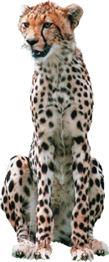
Allele Frequencies and Population Size
Aa
The allele frequencies of large populations are more stable because there is a greater reservoir of variability and they are less affected by changes involving only a few individuals.
Small populations have fewer alleles to begin with and so the severity and speed of changes in allele frequencies are greater.
Endangered species with very low population numbers or restricted distributions may be subjected to severe and rapid allele changes.
AA
aa
Aa
AA
Aa
Aa
Small population
Cheetahs have a small population with very restricted genetic diversity
aa
AA
AA
AA
AA
AA
aa
Aa
aa
Aa
aa
Aa
AA
Aa
aa
Aa
aa
aa
Aa
AA
Aa
Aa
Aa
Aa
Aa
Aa
Aa
Aa
Aa
Aa
Aa
Aa
Aa
aa
aa
Aa
AA
AA
AA
AA
Aa
Aa
aa
AA
AA
aa
AA
AA
Aa
Aa
Large population

Slide 24


Genetic Drift
For various reasons, not all individuals will be able to contribute their genes to the next generation. As a result, random changes occur in allele frequencies in all populations.
These random changes are referred to as genetic drift. In small, inbreeding populations, genetic drift may have pronounced effects on allele frequencies. Alleles may become:
  Lost from the gene pool (frequency = 0%)
  Fixed as the only allele present in the gene pool (frequency = 100%)
Genetic drift is often a feature of small populations that become isolated from the larger population gene pool, as with island colonizers (right).

Slide 25
Genetic Drift: Generation 1
In the following hypothetical example, the allele frequencies in the gene pool of a small population are recorded over three generations.
The allele combinations for each successive generation are determined by how many alleles of each type are passed on from the preceding one.
  Generation 1:
  As a result of the sparse
  distribution of the population,
  two beetles fail to locate a mate.
  This factor alone prevented
  them from contributing their
  genes to the next generation.
An example may be the
sparsely distributed individuals
of the Siberian tiger population.
A = 16 (53%) a = 14 (47%)
AA
Aa
Aa
Aa
aa
In the following hypothetical example involving the gene pool of a small population over three generations:
Not all individuals contribute alleles to the next generation.
With the random loss of the alleles carried by these individuals, the allele frequency changes from one generation to the next.
The change in frequency is ‘directionless’ as there is no selecting pressure.
The allele combinations for each successive generation are determined by how many alleles of each type 'survive' and are passed on from the preceding one.
AA
Aa
Aa
Aa
aa
AA
AA
Aa
Aa
aa
Fail to locate a mate

Slide 26
Genetic Drift: Generation 2
With the random loss of alleles carried by these individuals, the allele frequency changes from one generation to the next.
  Generation 2:
  Another two beetles fail to breed
  because they could not find a
  mate in the dispersed population.
  Two dark beetles were
  accidentally killed in a rock fall.
  This could equally have killed
  any beetle; it was not a test of
  the ‘fitness’ of the phenotype.
  The effect this had on the gene
  pool was to reduce the frequency
  of the dominant allele from 53%
  to 50%.
A = 15 (50%) a = 15 (50%)
AA
Aa
Aa
Aa
aa
AA
Aa
Aa
Aa
aa
AA
Aa
Aa
Aa
aa
Killed in a rock fall
Fail to locate a mate due to low population density

Slide 27
Genetic Drift: Generation 3
The change in allele frequencies is directionless; there is no selection pressure operating on the alleles.
  Generation 3:
  In another chance event, a
  dark beetle was blown out to
  sea by the strong winds during
  a cyclone.
  The effect on the gene pool
  was to further reduce the
  frequency of the dominant
A = 13 (43%) a = 17 (57%)
AA
Aa
Aa
aa
aa
AA
Aa
Aa
aa
aa
AA
Aa
Aa
Aa
aa
Killed in a cyclone

Slide 28
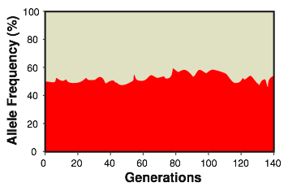
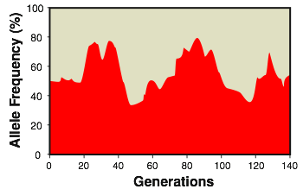
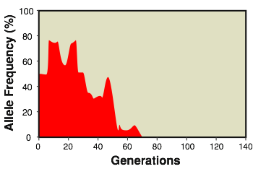
Genetic Drift in Populations
Large gene pool
Breeding population = 2000
Fluctuations are minimal because large numbers of individuals buffer the population against large changes in allele frequencies.
The changes in allele frequencies as a result of random genetic drift can be modelled in a computer simulation.
The breeding populations vary from 2000 (top) to 20 (bottom). Each simulation runs for 140 generations.
Small gene pool
Breeding population = 200
Fluctuations are more severe because random changes in a few alleles cause a greater percentage change in allele frequencies.
Very small gene pool
Breeding population = 20
Fluctuations are so extreme that the allele may become fixed (100%) or lost altogether (0%)
Allele lost from the gene pool

Slide 29
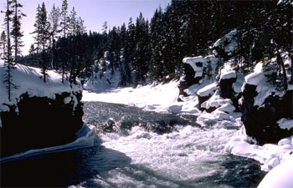
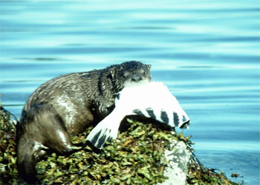
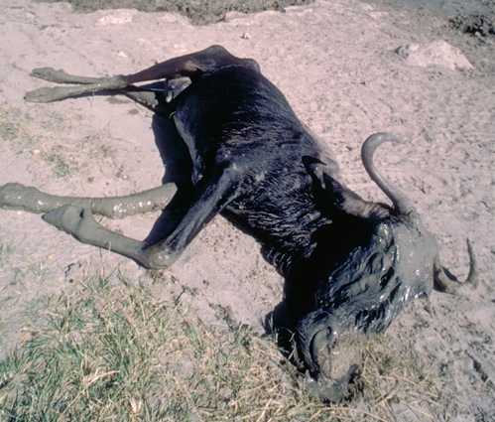
Population Bottlenecks
Populations may be reduced to low numbers through periods of:
As a result, only a small number of individuals remain in the gene pool to contribute their genes to the next generation.
The small sample that survives will often not be representative of the original, larger gene pool, and the resulting allele frequencies may be severely altered.
In addition to this ‘bottleneck’ effect, the small surviving population is often affected by inbreeding and genetic drift.
Seasonal climatic change
Heavy predation or disease
Catastrophic events (e.g. flood, volcanic eruptions, landslide)

Slide 30
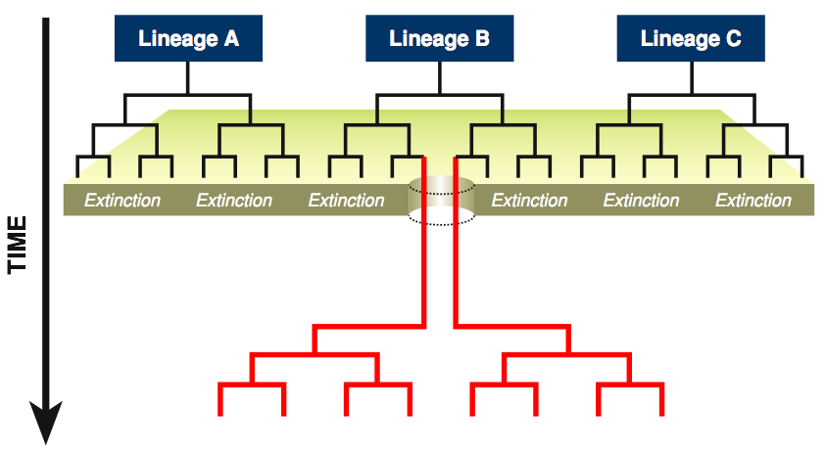
Population Bottlenecks
The original gene pool is made up of the offspring of many lineages (family groups and sub-populations)
Only two descendants of lineage B survive the extinction event
Genetic bottleneck
Extinction event such as a volcanic eruption
All present day descendants of the original gene pool trace their ancestry back to lineage B and therefore retain only a small sample of genes present in the original gene pool

Slide 31
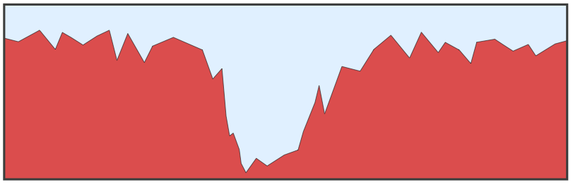
Population Bottlenecks
Large, genetically diverse population
Population reduced to a very low number with consequent loss of alleles
Population grows to a large size again, but has lost much of its genetic diversity
aa
AA
AA
Aa
Aa
AA
AA
AA
AA
Aa
AA
Aa
aa
AA
AA
Aa
Aa
AA
AA
AA
Aa
AA
AA
AA
AA
AA
AA
Aa
Aa
AA
AA
AA
AA
Aa
Population bottleneck: the population nearly becomes extinct as numbers plummet
Population numbers
Time

Slide 32
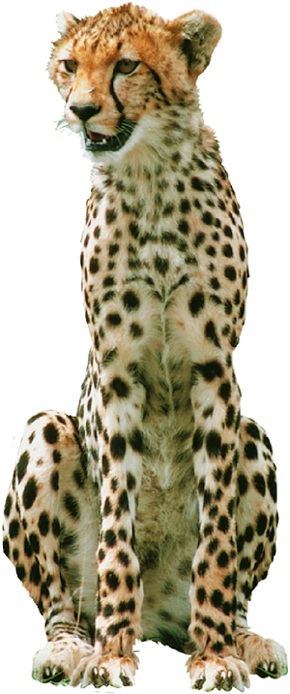
Genetic Bottlenecks & the Cheetah Population
The world population of cheetahs has declined in recent years to fewer than
20 000.
  Recent genetic analyses has found that the total cheetah population has very little genetic diversity.
  Cheetahs appear to have narrowly escaped extinction at the end of the last ice age: 10-20 000 years ago.
  All modern cheetahs may have arisen from a single surviving litter, accounting for the lack of diversity.
  At this time, 75% of all large mammals perished (including mammoths, cave bears, and saber-toothed cats).

Slide 33
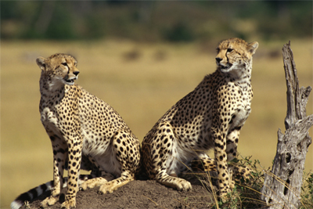
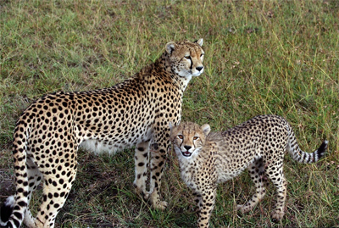
Genetic Diversity in Cheetahs
The lack of genetic variation has led to:
  sperm abnormalities
  decreased fecundity
  high cub mortality
  sensitivity to disease
Since the genetic bottleneck, there has been insufficient time for random mutations to produce new genetic variation.

Slide 34
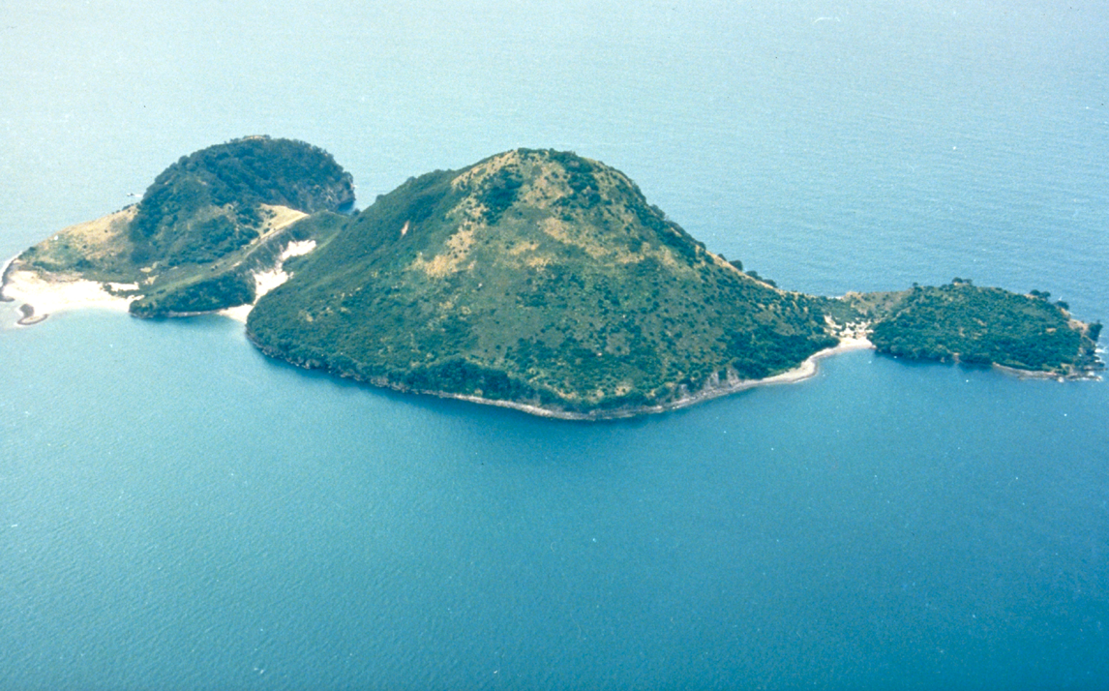
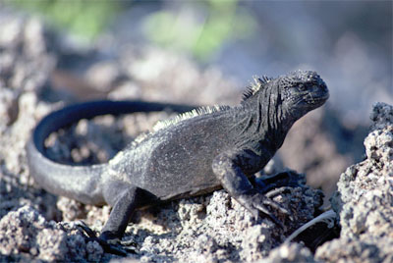
The Founder Effect
Occasionally, a small number of individuals may migrate away or become isolated from their original population.
This colonizing or founder population will have a small and probably non-representative sample of alleles from the parent population’s gene pool.
As a consequence of this founder effect, the colonizing population may evolve in a different direction than the parent population.
Offshore islands can provide an environment in which founder populations can evolve in isolation from the parental population.
The marine iguana of the Galapagos has evolved in an isolated island habitat

Slide 35
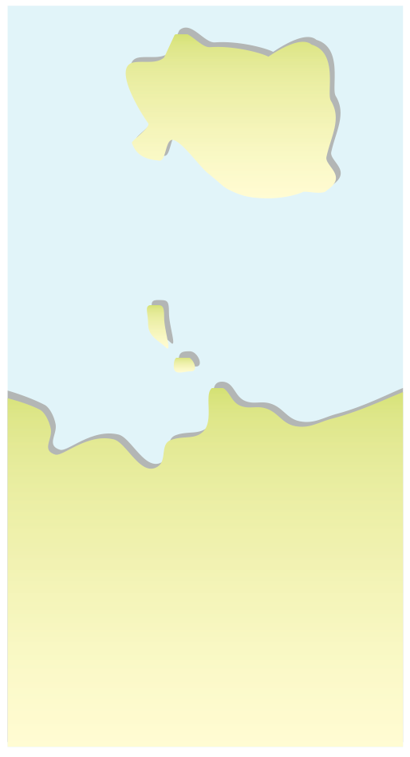



The Founder Effect
Island
population
Small founder populations are subject to the effects of random genetic drift.
The founder effect is typically seen in the populations of islands which are colonized by individuals from mainland populations.
Often these species have low or limited mobility; their dispersal is often dependent on prevailing winds (e.g. butterflies and other insects, reptiles, and small birds).
Colonization
Mainland
population

Slide 36
The Founder Effect
Colonizing island
population
Aa
AA
AA
AA
Aa
AA
Aa
Aa
Some individuals from the mainland population are carried at random to the offshore island by natural forces such as strong winds
This population may not have the same allele frequencies as the mainland population
In this hypothetical population of beetles, a small, randomly selected group is blown offshore to a neighboring island where they establish a breeding population.
Mainland
population
AA
Aa
AA
Aa
AA
aa
Aa
AA
AA
Aa
Aa
Aa
aa
aa
Aa
AA
aa
aa
Aa
AA
AA
AA
aa
Aa
AA
Aa
Aa
aa
AA
Aa
aa
AA

Slide 37
Natural Selection
Populations of sexually reproducing organisms consist of varied individuals, with some variants leaving more offspring than others.
This differential success in reproduction (differential
fitness) is called natural selection.
Natural selection is responsible for most evolutionary change by selectively altering genetic variation through differential survival and reproduction.
AA
Aa
aa
AA
Aa
Aa
AA
Aa
AA
Aa
Aa
AA
Aa
aa
aa
aa
Aa
Aa
AA
Aa
AA
Selection pressures may reduce the frequencies of certain alleles

Slide 38
Natural Selection
Natural selection acts on phenotypes by:
  Reducing the reproductive success of phenotypes poorly suited to the
  prevailing conditions; their alleles
  become less common in the gene pool.
  Enhancing the survival and
  reproductive success of phenotypes
  well suited to the prevailing conditions;
  their alleles become more common
  in the gene pool.
Natural selection therefore changes
the composition of a gene pool and increases the probability that favorable alleles will come together in the same individual.
AA
Aa
aa
AA
Aa
Aa
AA
Aa
AA
Aa
Aa
Aa
Aa
aa
AA
aa
Aa
AA
Aa
aa
AA
Phenotype with allele combination aa is more vulnerable to frost.

Slide 39
Assortative Mating
Random (non-assortative) mating allows all genotypes to have an equal chance of reproductive success.
Individuals may deviate from this by:
  Mating more often with close neighbors than with distant members of the population.
  Choosing mates that are most like themselves.
  Such behavior is call assortative mating.
AA
aa
aa
Aa
Aa
Aa
Aa
AA
Aa
AA
Random mating
AA
aa
aa
Aa
Aa
Aa
aa
AA
Aa
AA
Assortative mating

Slide 40
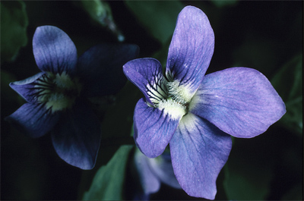
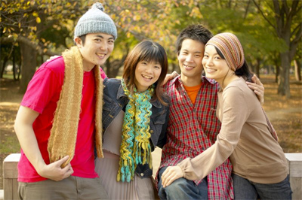
Assortative Mating
The most extreme case of assortative mating is self-fertilization in some plant species, e.g. violets.
Sometimes individuals may show random mating for some alleles but not others.
  Humans exhibit assortative mating for racial features, but mate randomly for blood types.
While assortative mating does not change the frequency of alleles in the overall gene pool, it does cause the ratio of genotypes to depart from that of random mating.
Violets can produce seed by both cross pollination or self pollination. Unlike cross-pollinated flowers (above), self-pollinated flowers are closed and are found near the soil surface.
Humans often find partners within their racial group.

Slide 41
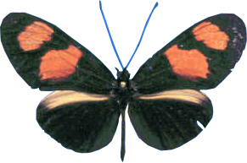




Modes of Natural Selection
Natural selection changes allele frequencies in populations, but it does not produce the “perfect organism”.
Rather than developing new phenotypes, it reduces the frequency of phenotypes that are less suited to the prevailing conditions (e.g. increased frequecy of heavy frosts).
Traits (e.g. skin color, height) that
are under polygenic control show quantitative variation in the phenotype. Natural selection acts
on this variation.
AA
Aa
aa

Slide 42






Stabilizing Selection
Natural selection may produce phenotypic change over time. The direction of change will depend on the nature of the selection pressure.
Stabilizing selection is probably the most common trend in natural populations; it favors the most common phenotype as the best adapted.
  Stabilizing selection reduces
  variation by selecting against
  the extremes at each end of
  the phenotypic range.
  The resulting bell shaped curve
  is narrower, about the same mean.
  EXAMPLE: Human birth weights
  (right) are maintained in the 3-4 kg
  range by selection pressures at
  the extremes.
Retained
Frequency
Eliminated
Eliminated
Variation in phenotype

Slide 43

Stabilizing Selection
Before selection there is a broad range of variation in the population:
After selection, and for some generations later, there is a reduction in the amount of variation.
Retained
Frequency
Eliminated
Eliminated
Frequency
Variation in phenotype

Slide 44


Stabilizing Selection in
Human Birth Weights
Stabilizing selection against extremes in the birth weight range results in most births being between 3-4 kg.
The histogram shows the percentage of births in each weight class. The red line shows the associated percentage mortality.
Modern medical intervention is reducing this selection pressure by increasing the survival.
Percent of births
Percent mortality
Birth weight (kg)
Selection against low birth weight babies with poor organ development
Selection against high birth weight (large babies) due to childbirth complications

Slide 45



Directional Selection 1
Most common during periods of environmental change.
Directional selection favors the phenotypes at one extreme of a phenotypic range.
Selection reduces variation at one extreme of the range while favoring variants at the other end.
The resulting bell shaped
curve shifts in the direction
of selection.
EXAMPLE: Fossil evidence
shows that the average size of
black bears in Europe increased
with each ice age, and decreased
again during the interglacials.
Retained
Frequency
Eliminated
Variation in phenotype

Slide 46

Directional Selection 2
Before selection (right) there is a broad range of variation in the population:
After selection (right) and some generations later there is a reduction in variation at one extreme of the range while favoring variants at the other end.
Retained
Frequency
Eliminated
Frequency
Variation in phenotype

Slide 47


Peppered Moths 1
The peppered moth, Biston betularia, occurs in two forms (or morphs):
  The mottled or gray form is well camouflaged and less conspicuous (to predators) against the lichen-covered bark of trees in unpolluted regions.
  The dark melanic forms are conspicuous in such environments as their body shape stands out against the background.
With the onset of the Industrial Revolution in England, the air quality declined, killing off lichen and resulting in a marked increase in the relative frequency of the dark moths.
  In a polluted environment, directional selection favored the melanic forms.
Gray or mottled form of the peppered moth Biston betularia; camouflaged on lichen
Melanic or carbonaria form of the peppered moth Biston betularia ; conspicuous on lichen, but camouflaged on soot-covered vegetation

Slide 48





Peppered Moths 2
In the 1940s and 1950s, coal burning was still intense around the industrial centers of Manchester and Liverpool.
During this time, melanic
forms remained dominant
in these regions.
In the rural areas further south and west of the industrial centers, the gray forms increased dramatically.
Industrial areas
Non-industrial areas
Frequency of peppered moth forms in 1950
Key to Frequency Graphs
Gray or speckled form
Melanic or carbonaria form

Slide 49



Peppered Moths 3
With the decline of coal burning factories and the Clean Air Acts in cities, the air quality improved between 1960 and 1980.
  Sulphur dioxide and smoke levels dropped to a fraction of their previous levels.
  This caused the proportion of melanic peppered moths to plummet…
  Now, with cleaner air,
  selection is increasingly
  in favor of the
  gray form.
Frequency of melanic peppered moth related to reduced air pollution
Melanic Biston betularia
Summer smoke
Winter sulfur dioxide

Slide 50

Disruptive Selection 1
Disruptive selection favors phenotypes at both extremes of a phenotypic range over intermediate variants. The bell shaped curve acquires two peaks (i.e. becomes bimodal).
Disruptive selection may occur when environmental conditions are varied or when the environmental range of an organism is large.
This type of selection can lead to the formation of clines or ecotypes (organisms of the same species that are slightly different in appearance), and polymorphism.
Eliminated
Frequency
Retained
Retained
Variation in phenotype

Slide 51


Disruptive Selection 2
Eliminated
Frequency
Retained
Retained
Before selection (right) there is a broad range of variation in the population:
After selection (right) and some generations later individuals at both extremes of a phenotypic range are favored over intermediate variants (two peaks).
Two peaks
Frequency
Variation in phenotype

Slide 52


Disruptive Selection in Mimics
An example of disruptive selection is seen in the mimicry complexes of African swallowtail butterflies.The African mocker swallowtail butterfly, Papilio dardanus, avoids predators by resembling poisonous butterfly species (it is a Batesian mimic).
It has a large range and, in various regions, it looks very different, depending on which species of poisonous butterfly it mimics. These Batesian mimics look like completely different species but are one.
Disruptive selection favours the extreme color patterns and nothing in between.
In Madagascar, where no noxious species are found, it exists as one morph.

Slide 53



Heterozygote Advantage
Sometimes, individuals that are heterozygous for a gene (Aa) are more common in the population than would be predicted using Hardy-Weinberg laws.
This is because the heterozygous condition can have a greater fitness than either homozygote (AA or aa).
This is termed heterozygote advantage.
Example: The mutant allele for sickle cell disease produces hemoglobin differing by one amino acid in the beta chain. This causes deformation of the red blood cells, which then have a tendency to clump together and cause circulatory and organ function problems.
Hb, Hb
All red blood cells are normal
Hb^{S}, Hb
Mix of normal and sickle red blood cells
Hb^{S}, Hb^{S}
All red blood cells are sickle shaped

Slide 54


Sickle Cell Gene
The heterozygote advantage of the sickle cell mutation is apparent in regions where malaria is endemic. Why?
  Malaria is transmitted by certain species of mosquito which spreads the intracellular protozoan parasite, Plasmodium.
  Sickle cells have low potassium levels and the parasites infecting these cells die.
  Individuals with a normal phenotype (Hb,Hb) are very susceptible to malaria. Heterozygotes (Hb^{S},Hb) are much less so. Sickle cell homozygotes (Hb^{S}, Hb^{S}) die from sickle cell disease.
  In regions where malaria is prevalent, the Hb^{S} allele is present in moderately high frequencies.
This is a balanced lethal system because neither of homozygotes produces a phenotype that survives.
Anopheles mosquito
Normal cells
Sickle
cell
Photo Defiers.com
Sickle cell: note its pale appearance

Slide 55


Sickle Cell Disease & Malaria
Frequency of sickle cell allele (Hb^{S})
Incidence of falciparum malaria.
Falciparum malaria is a particularly virulent form of malaria caused by Plasmodium falciparum. Falciparum malaria can be fatal within days of the first symptoms appearing.
There is a good correlation between the incidence of falciparum malaria and the frequency of the Hb^{S} allele.

Slide 56






Artificial Selection
Humans have controlled the breeding of domesticated animals and plants for centuries.
This practice, called artificial selection or selective breeding, involves breeding (selecting) from individuals with the most desirable phenotypes. It can result in an astounding range of phenotypic variation over relatively short time periods.
Selection imposed by humans is often more rapid and intense than that occurring in nature.
  Strong selection pressures can
  be applied to produce extremes
  of diversity and development.
Brassicas
Wheat and other grain crops
Domestic pigeons and doves
Domestic dogs (pug)

Slide 57





Artificial Selection in Brassica
Different parts of the wild brassica have been developed by human selection to produce at least six distinctly different vegetables.
All these vegetables form a single species and will interbreed if allowed to flower.
  Example: The new “broccoflower” is a cross between broccoli and cauliflower.
Cauliflower
(flower)
Broccoli
(inflorescence)
Cabbage
(terminal buds)
Brussels sprout
(lateral buds)
Kale
(leaf)
Wild Form
Brassica oleracea
Kohlrabi
(stem)

Slide 58



Hybrid Vigor
Hybrids are the progeny resulting from a cross between two genetically different individuals.
  Hybrids maybe identical to the parents in some traits but not all.
  Hybrids recombine traits of (often inbred) parental lines and show increased heterozygosity.
  This is associated with greater growth survival, and fertility in the offspring; a phenomenon known as hybrid vigor or heterosis.
  The reasons for hybrid vigor are not always clear. Heterozygotes may benefit from the effects of a number of different interactions expressed in the phenotype.
Parental strain A
Parental strain B
X
AAbbCCddEEff
aaBBccDDeeFF
Homozygous for many genes
Homozygous for many genes
Hybrid
AaBbCcDdEeFf
Heterozygous for many genes

Slide 59

Hybrid Corn
EXAMPLE: Hybrid corn is valued for its high productivity. It is produced by crossing inbred parental strains with a high degree of homozygosity.
Maize breeding program, Texas A&M University
Inbred A
Hybrid
Inbred B

Slide 60




Artificial Selection in Dogs
Dogs were probably first domesticated at least 14 000 years ago from a gray wolf ancestor.
Some 400 breeds have been bred from this single wild species as a result of selective breeding by humans.
  Example: The staffordshire bull terrier was
  produced by breeding bulldogs and terriers.
  From each litter, breeders selected pups with
  the characteristics they desired.
Bulldog
Gray wolf
Terrier
Staffordshire bull terrier
Staffordshire bull terriers combine characteristics of both bulldogs and terriers

Slide 61





Artificial Selection in Dogs
The gray wolf is distributed throughout Europe, North America and Asia. Amongst this species, there is a lot of phenotypic variation.
Selection is based on both physical and behavioral characteristics. In this way, different breeds have been suited to different tasks.
Five ancient dog breeds are recognized, from which all other breeds are thought to have descended by artificial selection.
Mastiff-type
Originally from Tibet, this breed dates back to the Stone Age
Pointer-type
Bred for the purpose of hunting small game.
Greyhound
One of the oldest breeds, originating the Middle East.
Sheepdog
Originated in Europe and bred for stock protection.
Wolf-type
Developed in snow-covered habitats in Alaska, northern Europe, and Siberia.

Slide 62


Slide 63
Terms of Use
Biozone International retains copyright to the intellectual property included in this presentation file, with acknowledgement that certain photos are used under license and are credited appropriately on the next screen.
You MAY:
  Use these slides for presentations in your classrooms using a data projector, interactive whiteboard, and overhead projector.
  Place these files on the school’s intranet (school computer network), but not in contradiction of clause 3 (a) below.
  Edit and customize this file by adding, deleting, and modifying information to better suit your needs.
  Place these presentation files on any computer within the school, including staff laptops.
  Print out this file in PowerPoint “Handouts” format as per the print dialogue box, for the express purpose of allowing students to make their own notes about the presentation.
You MAY NOT:
  Put these presentation files onto the internet or on a service that may be accessed offsite from the campus, unless access to the service is protected by a user login and password protocol.
  Print these files onto paper to make your own worksheets for distribution to students.
  Create a NEW document using any of the graphics/images in this presentation file.
  Incorporate any part of this presentation file for the production of another commercial product.
  REMOVE any of the references to Biozone, the copyright notices, photo credits, or terms of use from this file.

Slide 64

Photo Credits
Photographic images are used under licence from the following photo libraries:
  Corel Corporation Professional Photos
  ArtToday.com, Clipart.com
  iStockPhotos.com
  PhotoDisc Inc.
  Hemera Technologies Inc.
  PhotoObjects.com
  Photos.com
  SkullsUnlimited.com
Additional artwork and photographs are the property of Biozone International Ltd.
BIOZONE International Ltd | P.O. Box 13-034, 109 Cambridge Road, Hamilton, NEW ZEALAND
Phone: + 64 7 856-8104 | Fax: + 64 7 856-9243 | E-mail: sales@biozone.co.nz | Internet: www.biozone.co.nz
Copyright © 2005 Biozone International Ltd
All rights reserved

Slide 65







Presentation MEDIA
See our other titles:
See full details on our web site:
www.thebiozone.com/media.html

